Slide 1

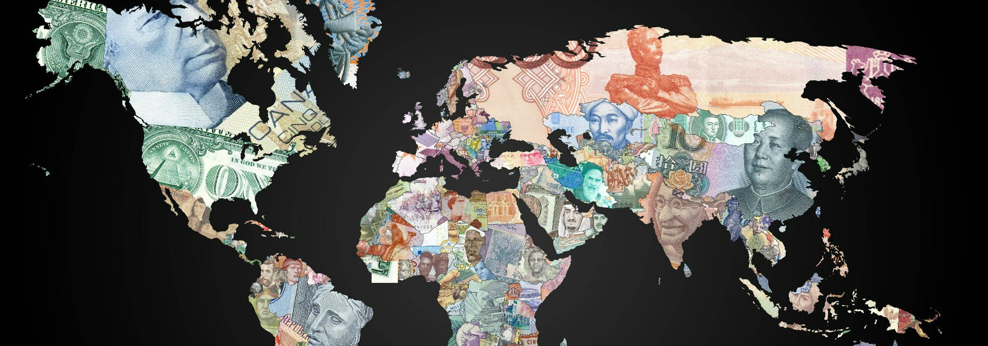
Military Expenditure
DATS 6103 - Individual Project 1 – Vishnupriya Venkateswaran
Notes:
Add pictures and style

Slide 2
Overview
Background of Dataset
Trends in Military Spending
Trends in Share of GDP
Military spending per capita
GDP per capita
Data Visualization
Conclusion
Tools and Packages
Reference

Slide 3
Background of Dataset
SIPRI Military Database(Stockholm international peace research institute):
The SIPRI Military Expenditure Database contains consistent time series on the military spending of countries for the period 1949–2016
Share of GDP and per capita are presented according to calendar year.
Internation Monetary Fund(Imf):
Contains the GDP per capita of countries for the period 1980-2018

Slide 4
G-20 Countries
Argentina
Australia
Brazil
Canada
China
France
Germany
India
Indonesia
Italy
Japan
Republic of Korea
Mexico, Russia
Saudi Arabia
South Africa
Turkey
the United Kingdom
the United States.
Notes:
Explain why Europian Union is not considered

Slide 5
Trends In Military Spending
World military expenditure was $1686 billion in 2016.
The five biggest spenders in 2016 were the USA, China, Russia, Saudi Arabia and India.
Military expenditure increased in Asia and Oceania, Europe (Central, Eastern and Western) and North America.
Military spending decreased in Africa, Central America and the Caribbean, and South America.
Of the countries in the Middle East for which data is available, total military expenditure fell by 17%; the major decreases were in Iraq (–36%) and Saudi Arabia (–30%)
Military expenditure in the USA grew by 1.7% to $611 billion in 2016, the first increase after five consecutive years of decline. Despite this slight increase, US military spending remains 20% lower than the peak of 2010.
The fall and continued slump in world oil prices has had a substantial effect on military spending in a majority of oil-export dependent countries. In many cases (e.g. Saudi Arabia, South Sudan and Venezuela), country-specific cuts have been so substantial that they have affected regional and sub-regional spending trends.

Slide 6
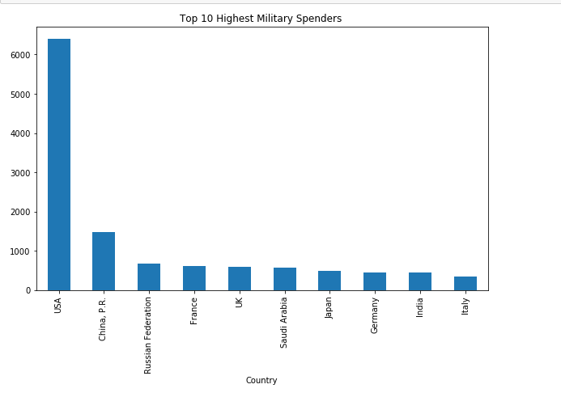
Top 10 Highest Spending Countries from 2007-2016
Notes:
ReplCE GRAGH

Slide 7
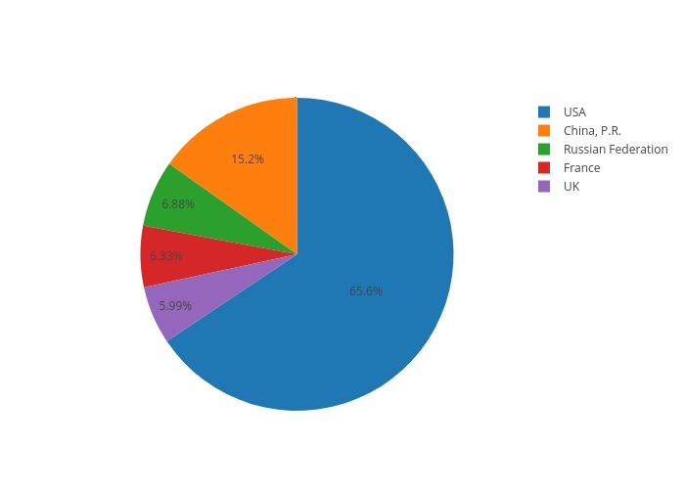
Military Spending of top 5 countries

Slide 8
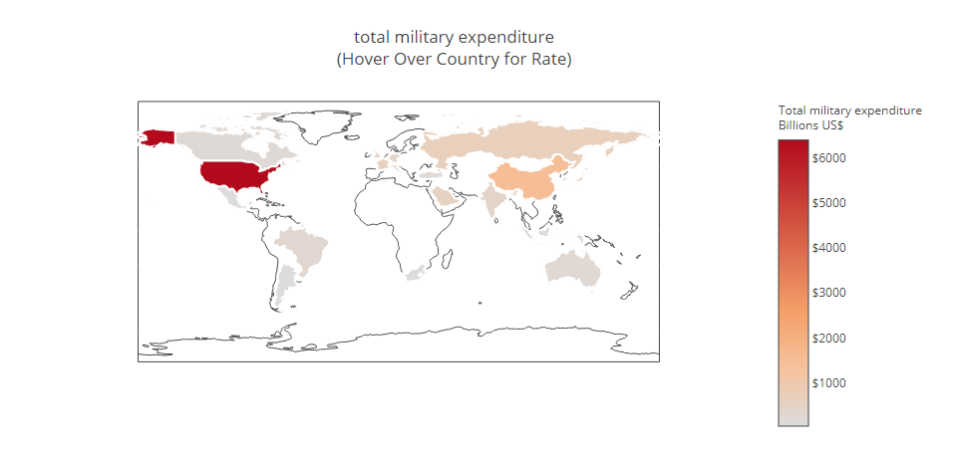
Data Visualization

Slide 9
Trends in Share of GDP
Total military spending accounted for 2.2% of the global GDP in 2016.
Saudi Arabia is spending more on its armed forces than ever before, boosting its military budget by 10.4% in 2016.
The military now amounts to at least 8.5 % of the united kingdom's GDP, according to an estimate from SIPRI.
By contrast, USA’s enormous military expenditure "only" amounts to 3.3% of GDP. In China, that falls to 1.9%.
Russia has embarked on a huge military spending binge which was estimated to have reached 5.3 % of its GDP in 2016.

Slide 10
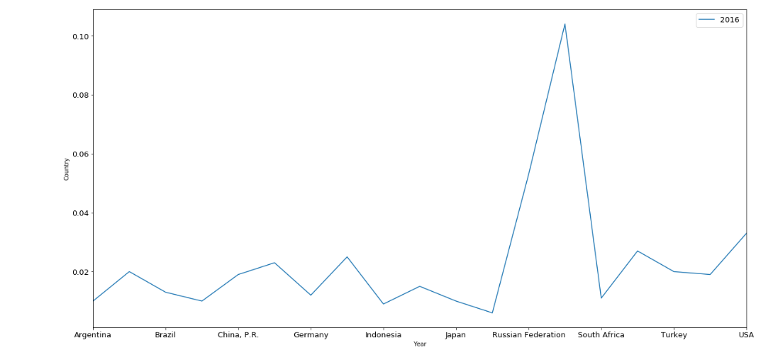

Slide 11
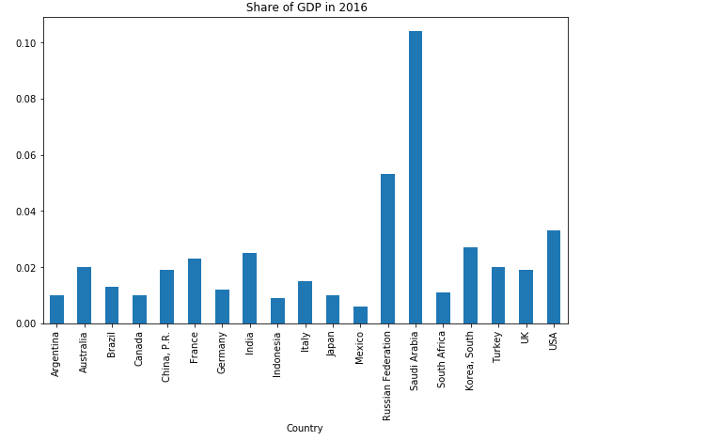
To do
Notes:
Compare the data to that country’s GDP(to do)

Slide 12
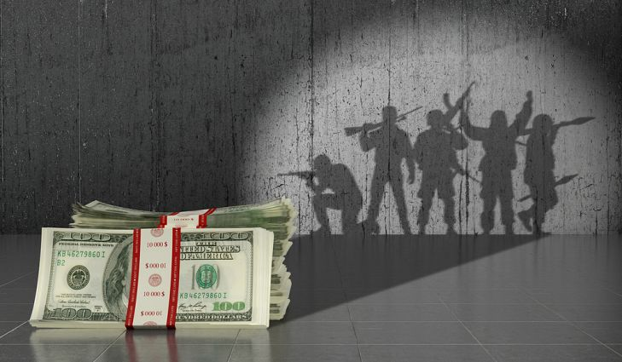
Military Spending per Capita
Saudi Arabia spent 1978.20 USD per capita on their military operations in 2016. It is the country that spends the highest amount per capita on military in the world. It even beats Israel and United States which are known to engage in many wars around the globe.
Saudi Arabia beat USA in military spending per capita after 2013.
From 2007 to 2016 USA has spent 20432.80USD per capita whereas Saudi Arabia 19083USD.
The increase was only after 2013.

Slide 13
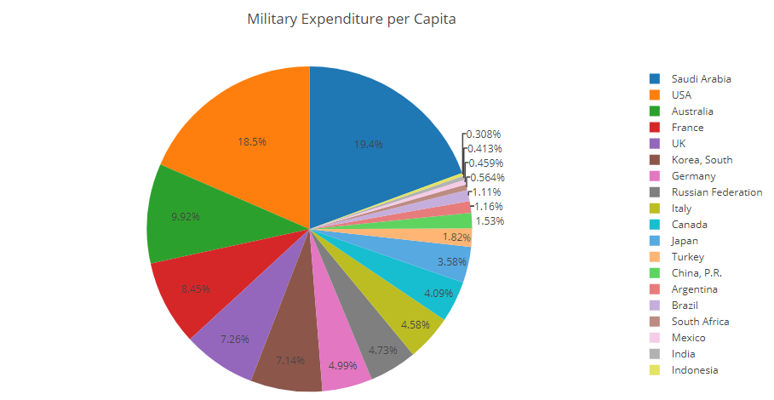

Slide 14
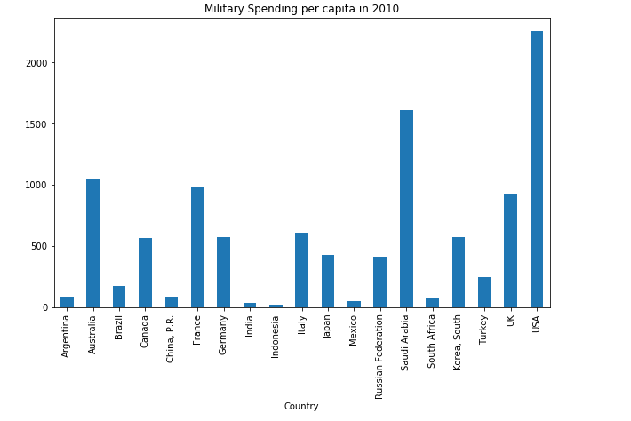
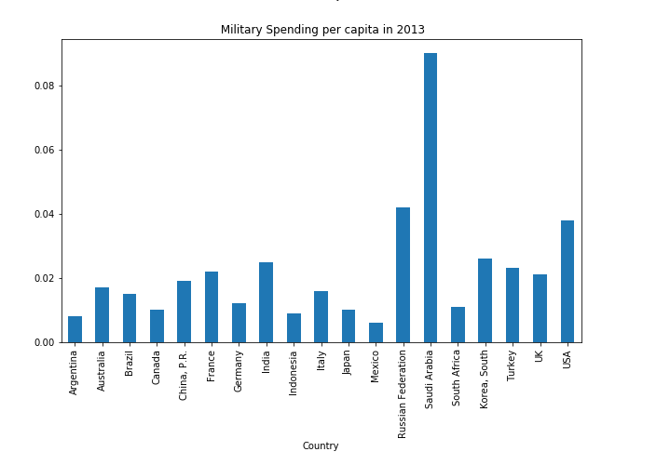
Military spending per capita for 2010 and 2013
Notes:
Put Final choropleth

Slide 15
GDP per Capita
GDP per capita allows you to compare the prosperity of countries with different population sizes. US GDP was $18.56 trillion in 2016 according to the IMF. But one reason America is so prosperous is it has so many people. It's the third most populous country after China And India.
The United States must spread its wealth among 324 million people. As a result, its GDP per capita is only $57,607.
China has a large GDP, producing $21.2 trillion in 2016. But its GDP per capita was only $8123 because it has four times the number of people as the United States.
It's the most populous country in the world, with 1.37 billion people.
India's GDP was $8.7 trillion, but spread among its 1.3 billion people, its GDP per capita was $1741.
Japan’s GDP is $4.9 trillion, the fifth largest in the world. Its GDP per capita was $38,900 since it has 126 million people.

Slide 16
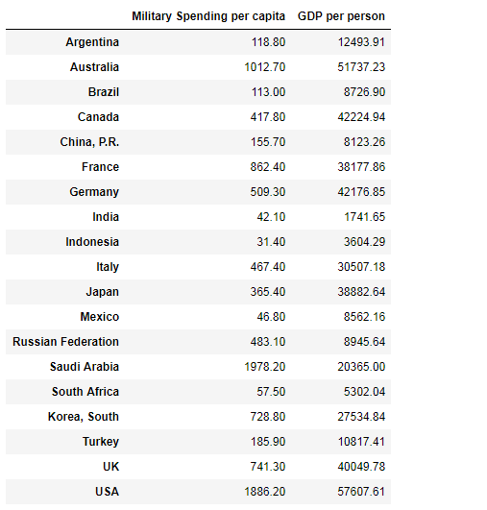
Comparison btw per person military spending to the per person GDP

Slide 17
Conclusion
USA spends the most amount of money on military.
The five biggest spenders in 2016 were the USA, China, Russia, Saudi Arabia and India.
Saudi Arabia has the highest share of GDP.
Saudi Arabia is the country that spends the highest amount per capita on military in the world. It beats United States which is known to engage in many wars around the globe.

Slide 18
Tools and Packages
Python
Libraries
pandas
Matplotlib.pyplot
Numpy
Display
Math
Charts
plotly
Histograms
Line graphs
Choropleth

Slide 19
Reference
https://www.sipri.org/databases/milex
http://www.imf.org/external/datamapper/NGDPDPC@WEO/OEMDC/ADVEC/WEOWORLD
https://data.worldbank.org/indicator/NY.GDP.MKTP.CD

Slide 20
THANK YOU…

